Slide 1
Google Scholar
An introduction to the abilities and benefits of using Google Scholar
By: Kristin Bernet
April 2012
Notes:
In this brief tutorial we will examine Google Scholar. What it is, How to use it, and why you would want to use it.

Slide 2
Who? What? Why?
What is Google Scholar?
Why use Google Scholar?
Google Scholar provides a simple way to broadly search for scholarly literature
From one place, you can search across many disciplines and sources: articles, theses, books, abstracts and court opinions, from academic publishers, professional societies, online repositories, universities and other web sites
Google Scholar employs the same simple and familiar search bar as the more popular and mainstream Google search but it’s search results are limited to scholarly resources
Some articles in Google Scholar include a direct link to the full-text electronic version of an article
Google Scholar search results include: “cited by”, “related article” links, and more
Notes:
Google Scholar is a branch of Google’s main search engine. It provides a simple springboard for searching the internet for scholarly resources, such as articles, legal opinions, briefs, and theses; from a wide range of sources including academic scholarly publications, professional societies, online repositories, universities, and more.
Google scholar is simple and intuitive to use. It’s search results include direct links to the full-text of an article when it is available online and links to view related articles, cited by articles, and more.

Slide 3
Google Scholar: How To
http://scholar.google.com
Access Google Scholar
Search Google Scholar
Explore search results
Notes:
So let’s take a look at Google Scholar and see how it works in action:
1. Go out to computer screen of GS home page
There are several ways to access Google Scholar but the simplest way is to enter “scholar.google.com” (voom in to web address) into your web browser and go directly to the scholar home page. (Pause recording and go to live- screen capture of library’s homepage)
2. Using GS to Search
Use Google Scholar the same way as you use their mainstream search engine, by entering your most specific search terms. Fore example: enter keywords, title, author, or a search phrase: (enter)→ Washington AND "Urban Architecture“ and select “search”
3. Google Scholar Search Results
From the search results list you can create an email alert (highlight with cursor), see a list of those who cited a particular article (highlight with cursor), review related articles (highlight with cursor), or if the full-text is available online you can use the direct link on the right-side of an article to access it (in Editing add bubble note)
If an article is not freely available in it’s entirety via Google Scholar please see your local librarian for information about gaining access to the full-text version.
It is also important to note that Google Scholar does not search the entirety of scholarly resources available since some publishers, repositories, and websites do not allow access to the Google Scholar web crawler to search their resources

Slide 4
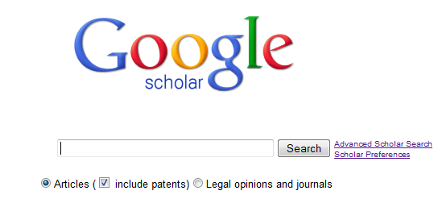
http://scholar.google.com
Notes:
Google Scholar is a great place to begin your research. For more advanced search capabilities, select the “Advanced Scholar Search” link located on the right-hand side of the search bar. Happy Searching!

